Slide 1
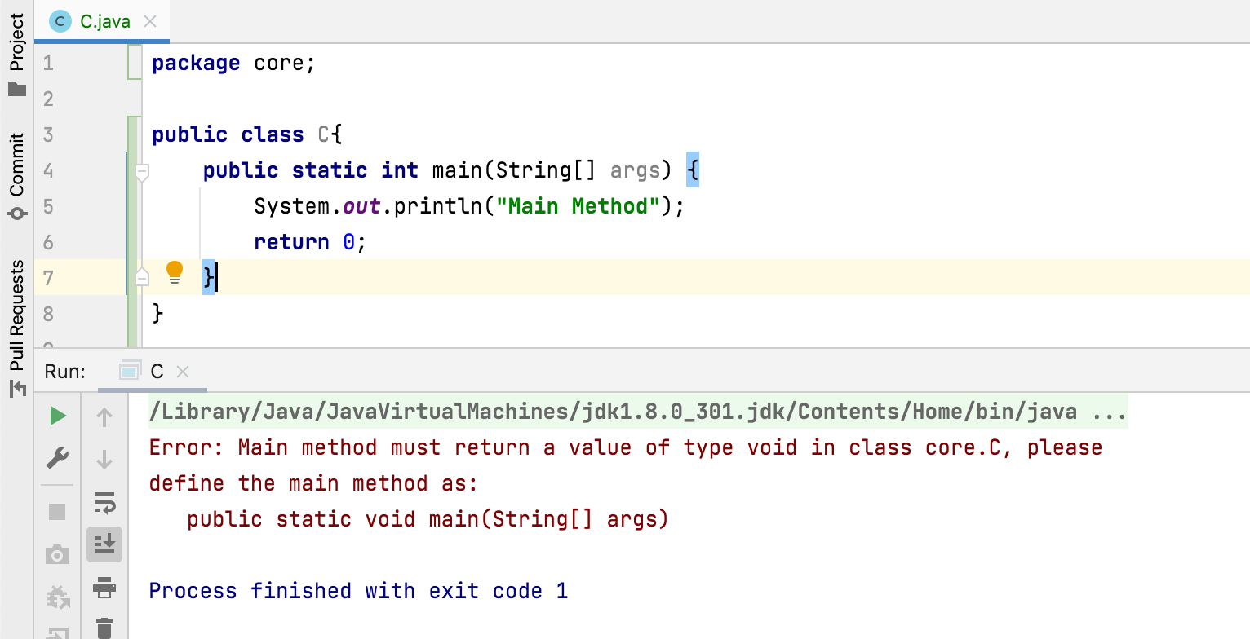
Can we change the return type of a main() method?
No, the return type of main() method must be void only.

